Slide 1

Impact of Missed Appointments on Hospital Finances and Quality of Care
Furhan Babar
Mary Grace Boyd

Slide 2
Introduction
New York City Health + Hospitals has focused its vision, mission, and created strategic pillars to help grow and develop the health system as it continue to serve and improve health and quality of life of our community members.
To ensure success, Harlem Hospital Center continues to strive for excellent quality care and financial sustainability using quality improvement strategies that relies on data analytics to effectively measure outcomes.
Understanding baseline information on the financial impact of missed or no-show appointments and trend analysis on variables affecting these rates are vital in achieving financial sustainability and improvement of quality of care at Harlem Hospital Center.

Slide 3
Data Sources
Initial raw data on missed or no-show appointments was acquired from EPIC Reporting Work Bench for Harlem Hospital Center
Weather data was acquired from National Oceanic and Atmospheric Administration’s (NOAA) National Centers for Environmental Information (NCEI)

Slide 4
Methodologies
MS Excel Spreadsheet – raw data gathering and initial visualization
Python using Google Colab – data cleaning, data wrangling, and exploratory data analysis
Tableau – data visualization using worksheets, dashboards, and storyboards
MS PowerPoint Presentation – presentation of final data

Slide 5
ANALYSIS & FINDINGS

Slide 6
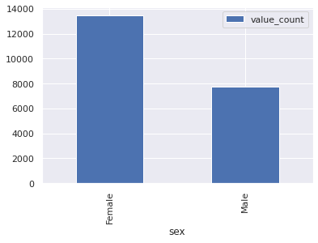
Occurrence by Gender
There are higher incidence of female patients that missed their appointments

Slide 7
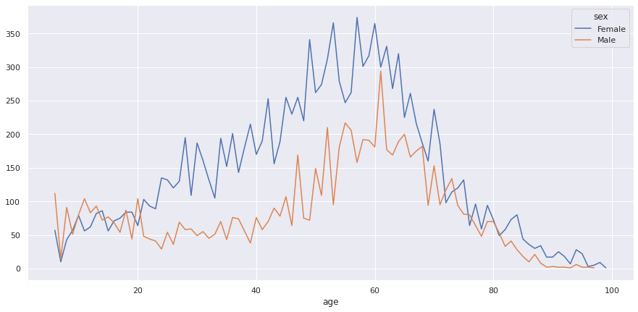
Occurrences by Gender and Age
Female patients missed more appointments than their male counterparts across age groups with some overlap on during under 20 age group.

Slide 8
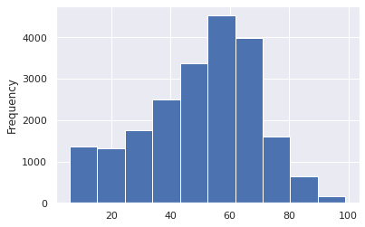
Age Distribution
Age distribution is left-skewed (negative skewness).
Minimum age = 1 | Mean age = 50.12 | Maximum age= 99 | Median age = 53

Slide 9
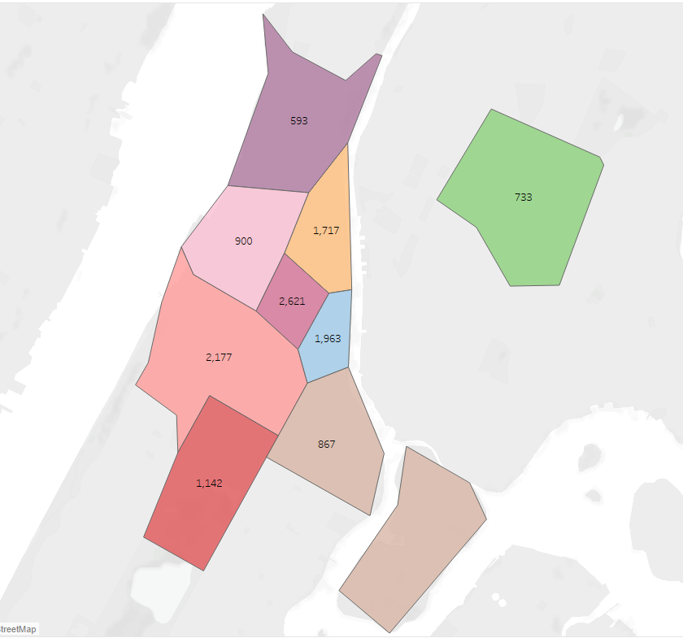
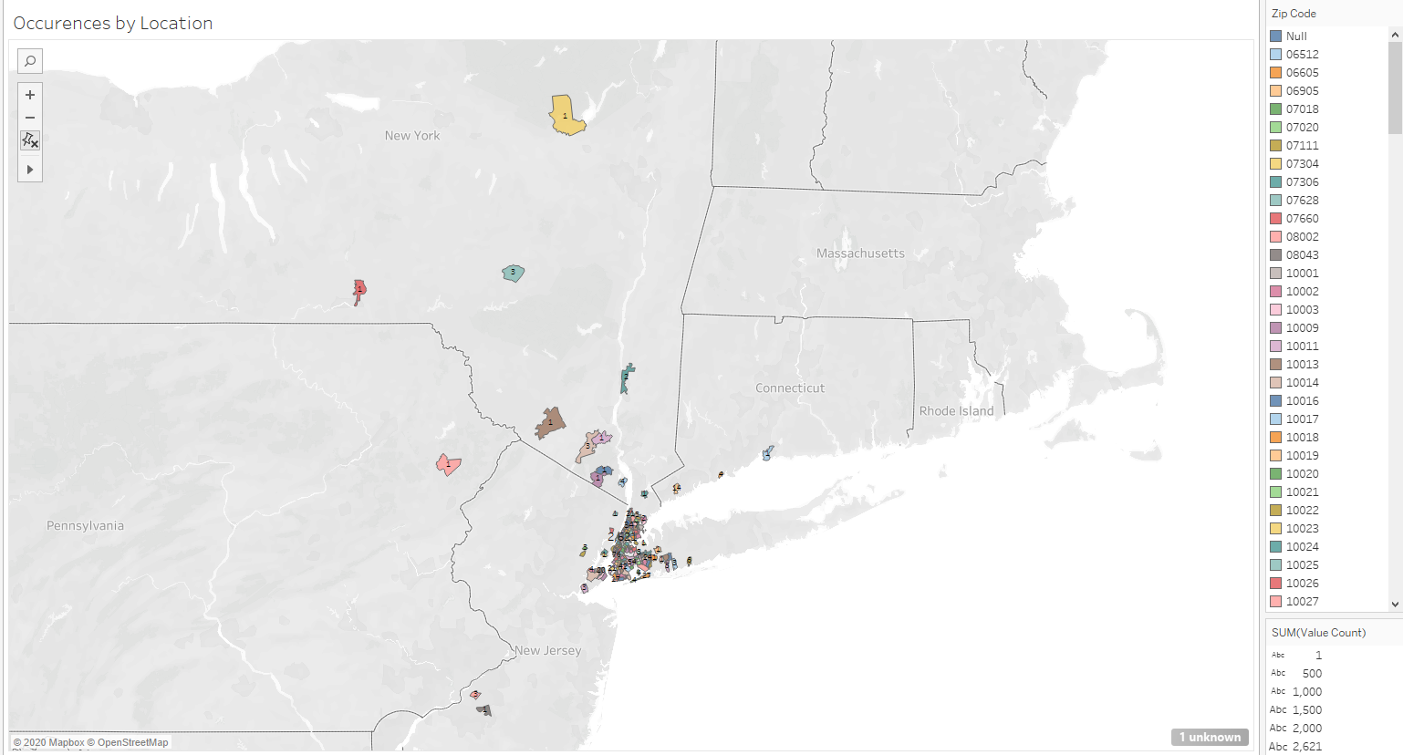
By State & Zip Code

Slide 10
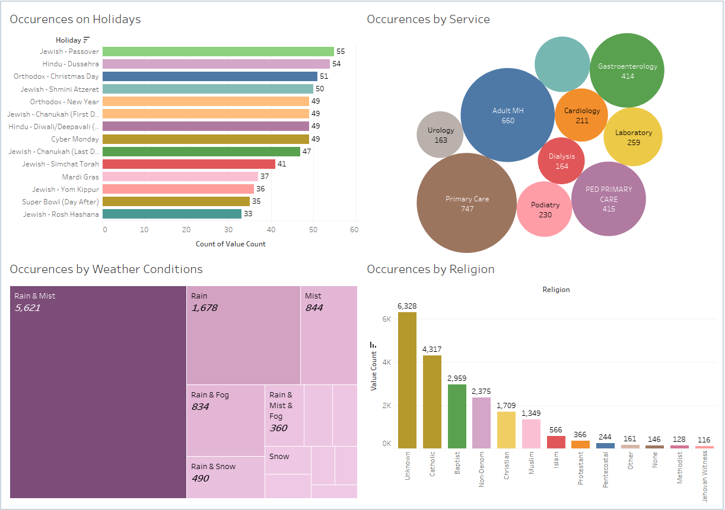

Slide 11
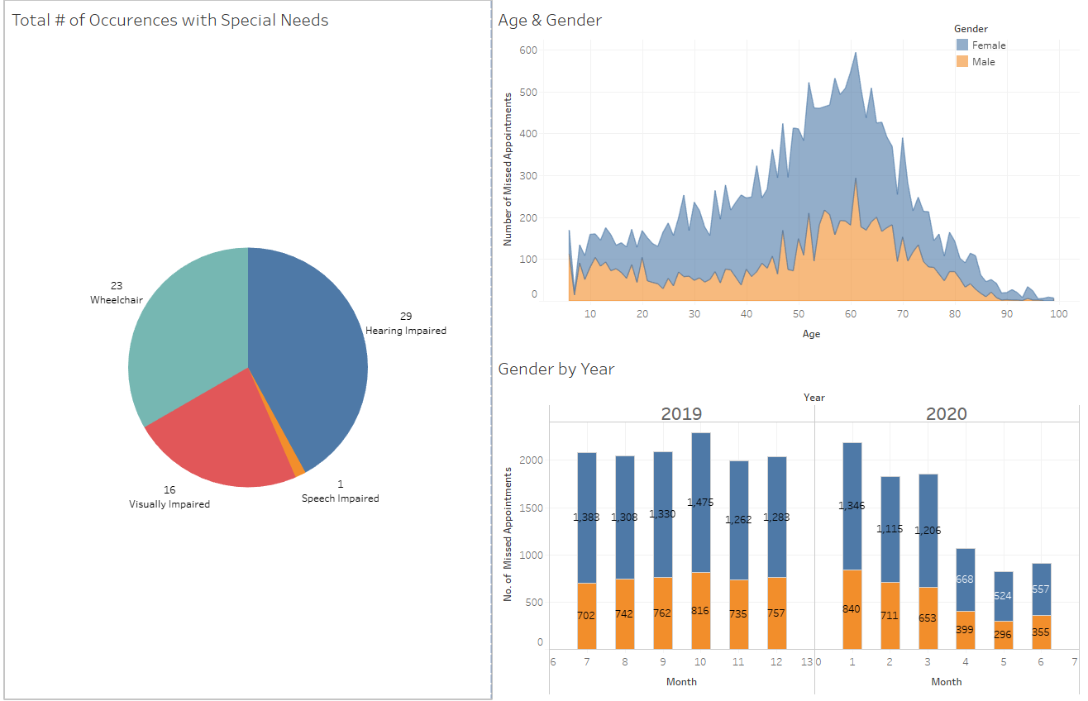

Slide 12
CONCLUSION

